Slide 1
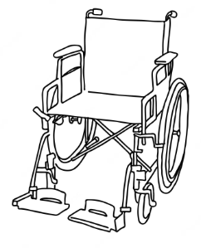


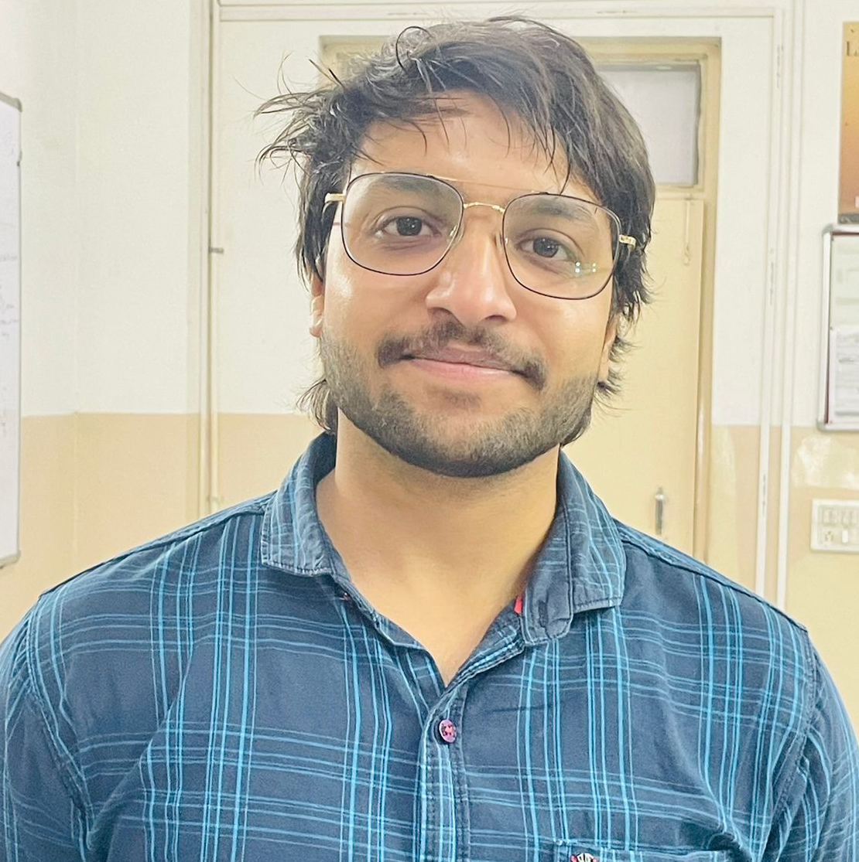

ULTRA-TECH ELECTRIC WHEEL CHAIR
TEAM-2313
DEVANSH GUPTA
HARSH SINGH
PIYUSH KHANNA
DR.HIMASNSHU CHAUDHARY
COLLEGE-KIET GROUP OF INSTITUTIONS
LOCATION-GHAZIABAD,UTTAR PRADESH,201206
FACULTY MENTOR-DR.HIMANSHU CHAUDHARY

Slide 2

Index
Challenge Statement
Concept of the Solution
Novelty / Scope of Solution
Pros and Cons of the solution
Technical Description
Implementation Plan
Validation/Testing/Analysis
Cost Estimate
Assumptions
References

Slide 3

CHALLENGE STATEMENT
Limited mobility
Fatigue and Exhaustion
Risk of Falling and injuries
Limited Accessibility
Dependence on Others
Social Isolation
Mental Health issue
Stigma and Discrimination

Slide 4





CONCEPT OF SOLUTION
Seat Elevation
Cheaper
RENTING FACILITY
APP TRACKING
Obstacle Detection

Slide 5

NOVELTY
Uncover learning potential for differently abled
It will reduce conditions of social isolation , anxiety and depression
Independent mobility
Reduce the hustle to carry wheelchair at public places
Pocket friendly

Slide 6
PROS AND CONS
PROS
CONS
Increased mobility
Easy operation
Reduced physical strain
Comfort and customization
Safety features
Independence and social engagement
Enhanced maneuverability
Technical malfunctions
Learning curve
Size and weight
Maintenance and repairs
Limited battery life

Slide 7
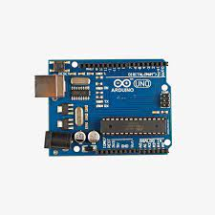
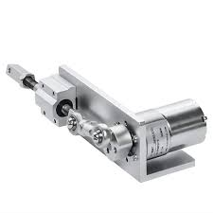
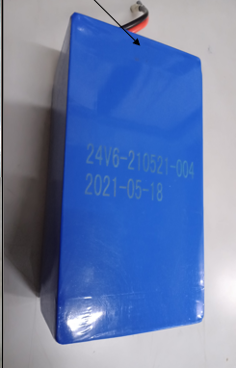
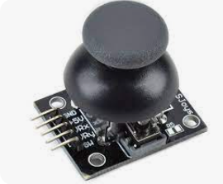
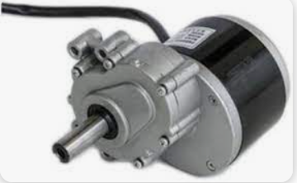
TECHNICAL DESCRIPTION
360degree JOYSTICK
Arduino UNO
24V GARED MOTOR
LINEAR ACTUATOR
26V LITHIUM IRON PHOSPHATE BATTERY
WE HAVE USED KOTLIN FOR THE APP DEVELOPMENT AND HTML/CSS FOR THE WEBSITE DEVELOPMENT

Slide 8
IMPLEMENTATION PLAN
TYPES OF FEATURES/SERVICES
FULLY AUTOMATED WHEELCHAIR
CUSTOMISED WHEEL CHAIR
RETROFITTED WHEEL-CHAIR
LIVE APP TRACKING
RENTING FACILITY AT PUBLIC
PLACES
BUSINESS PLAN/REVENUE MODEL
B2B and B2C market scenarios
NGO
Government funding schemes
APP REVENUE
RENTING REVENUE

Slide 9
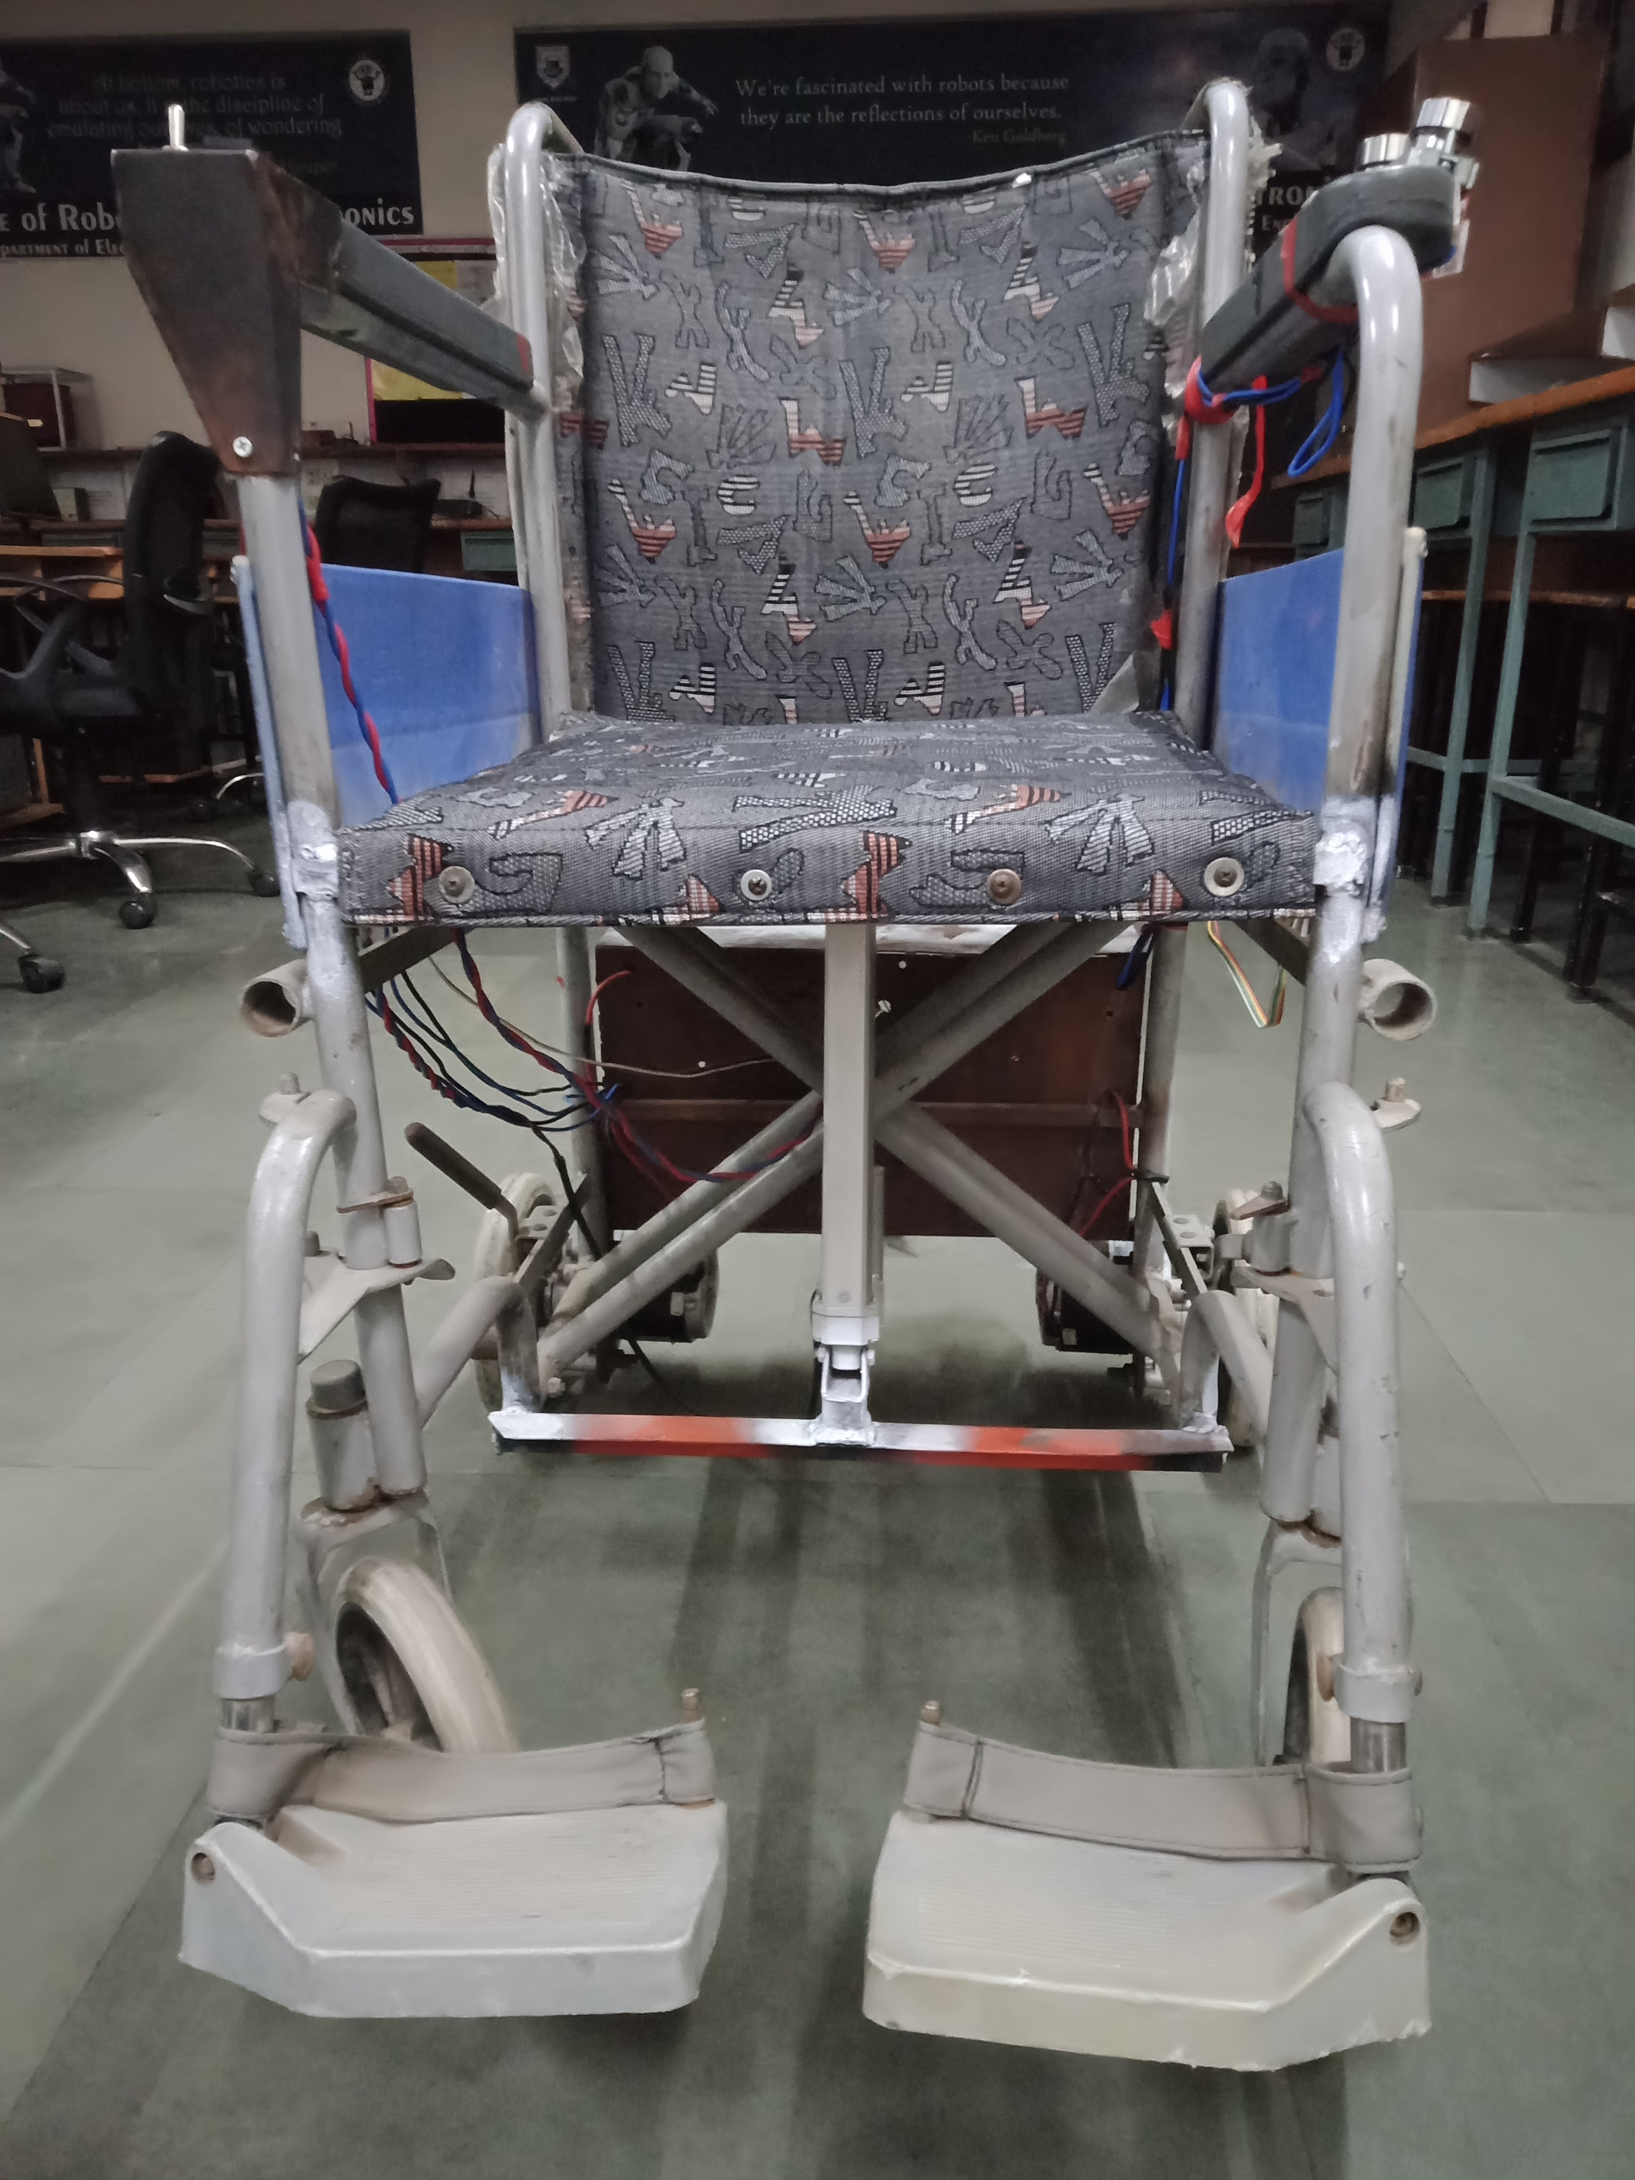
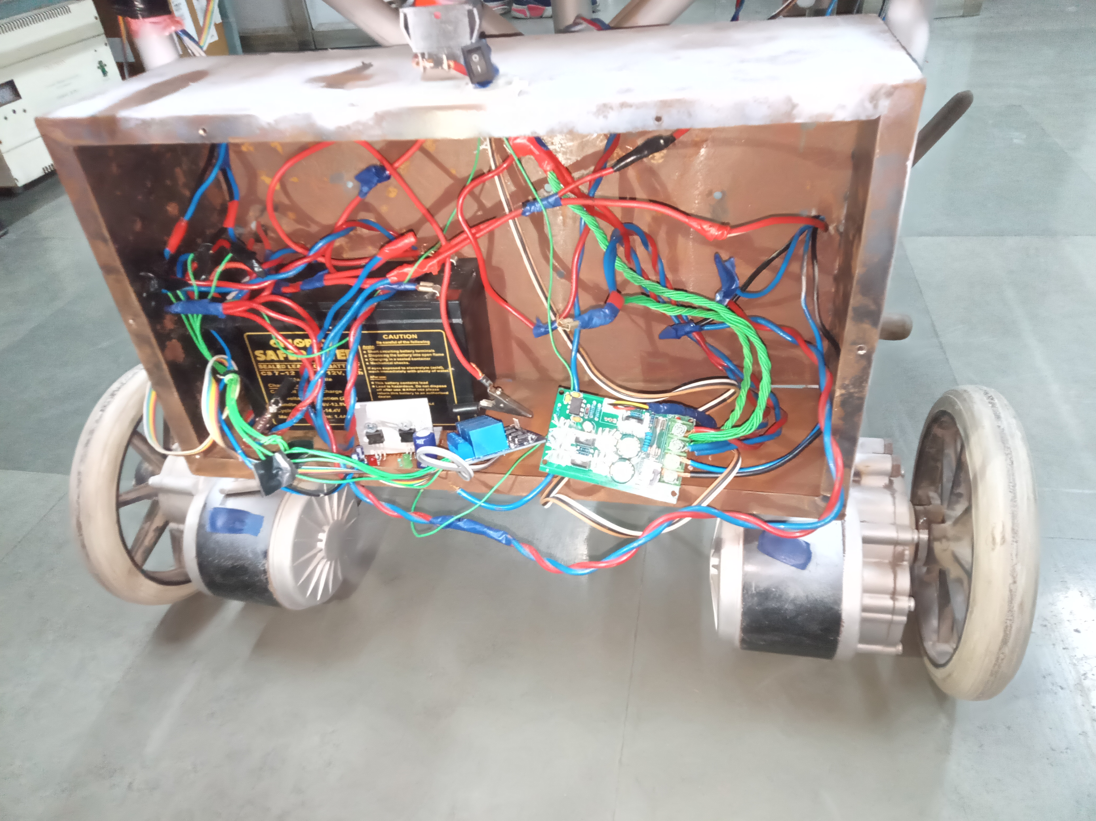
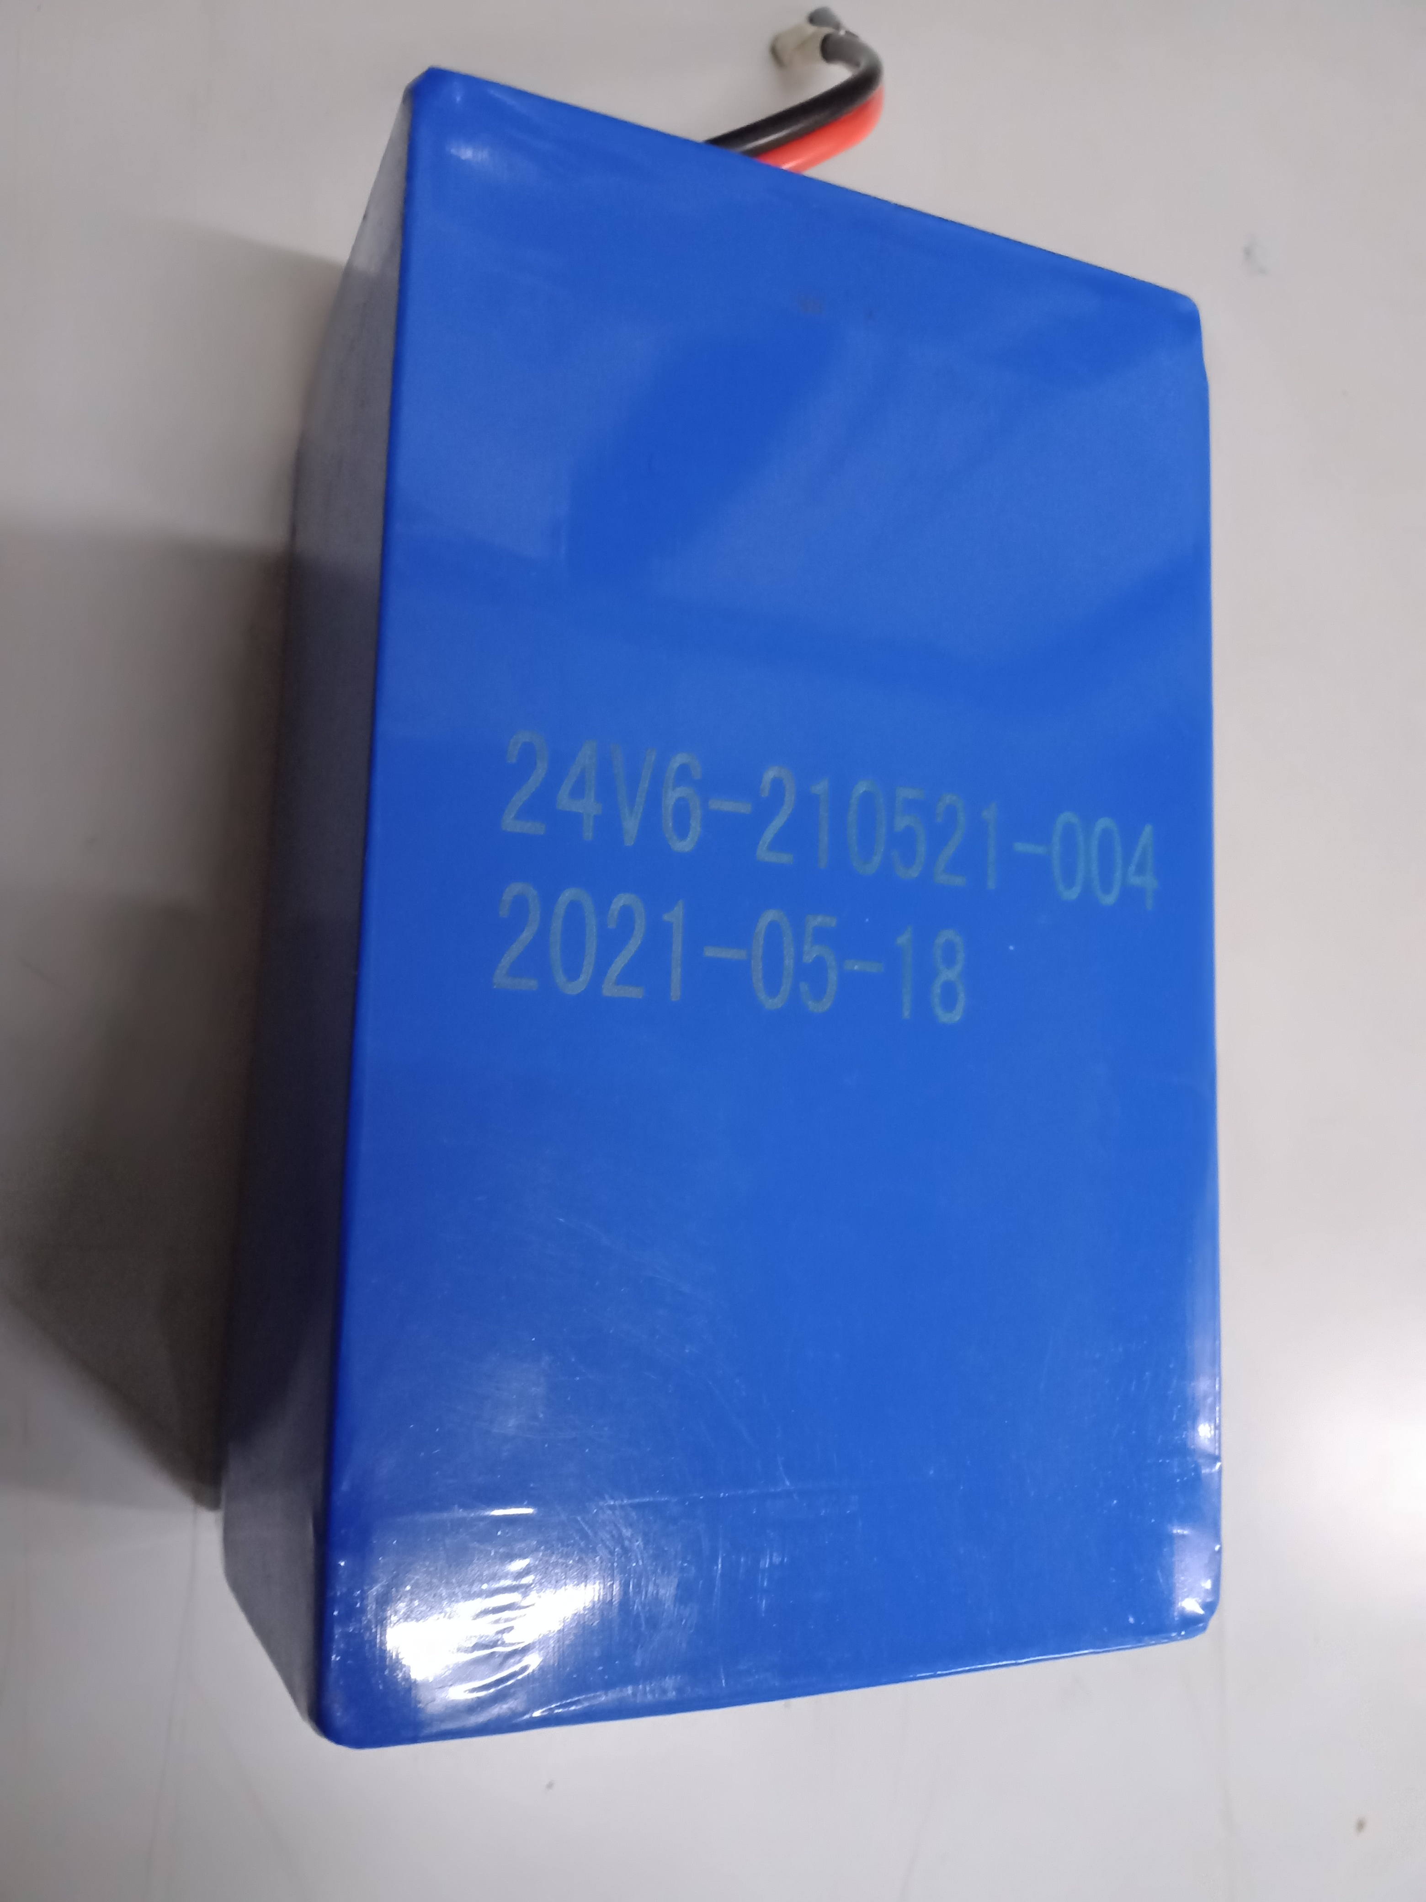
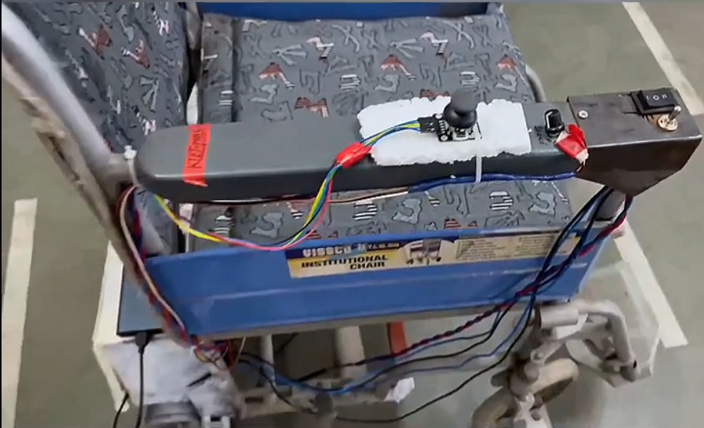
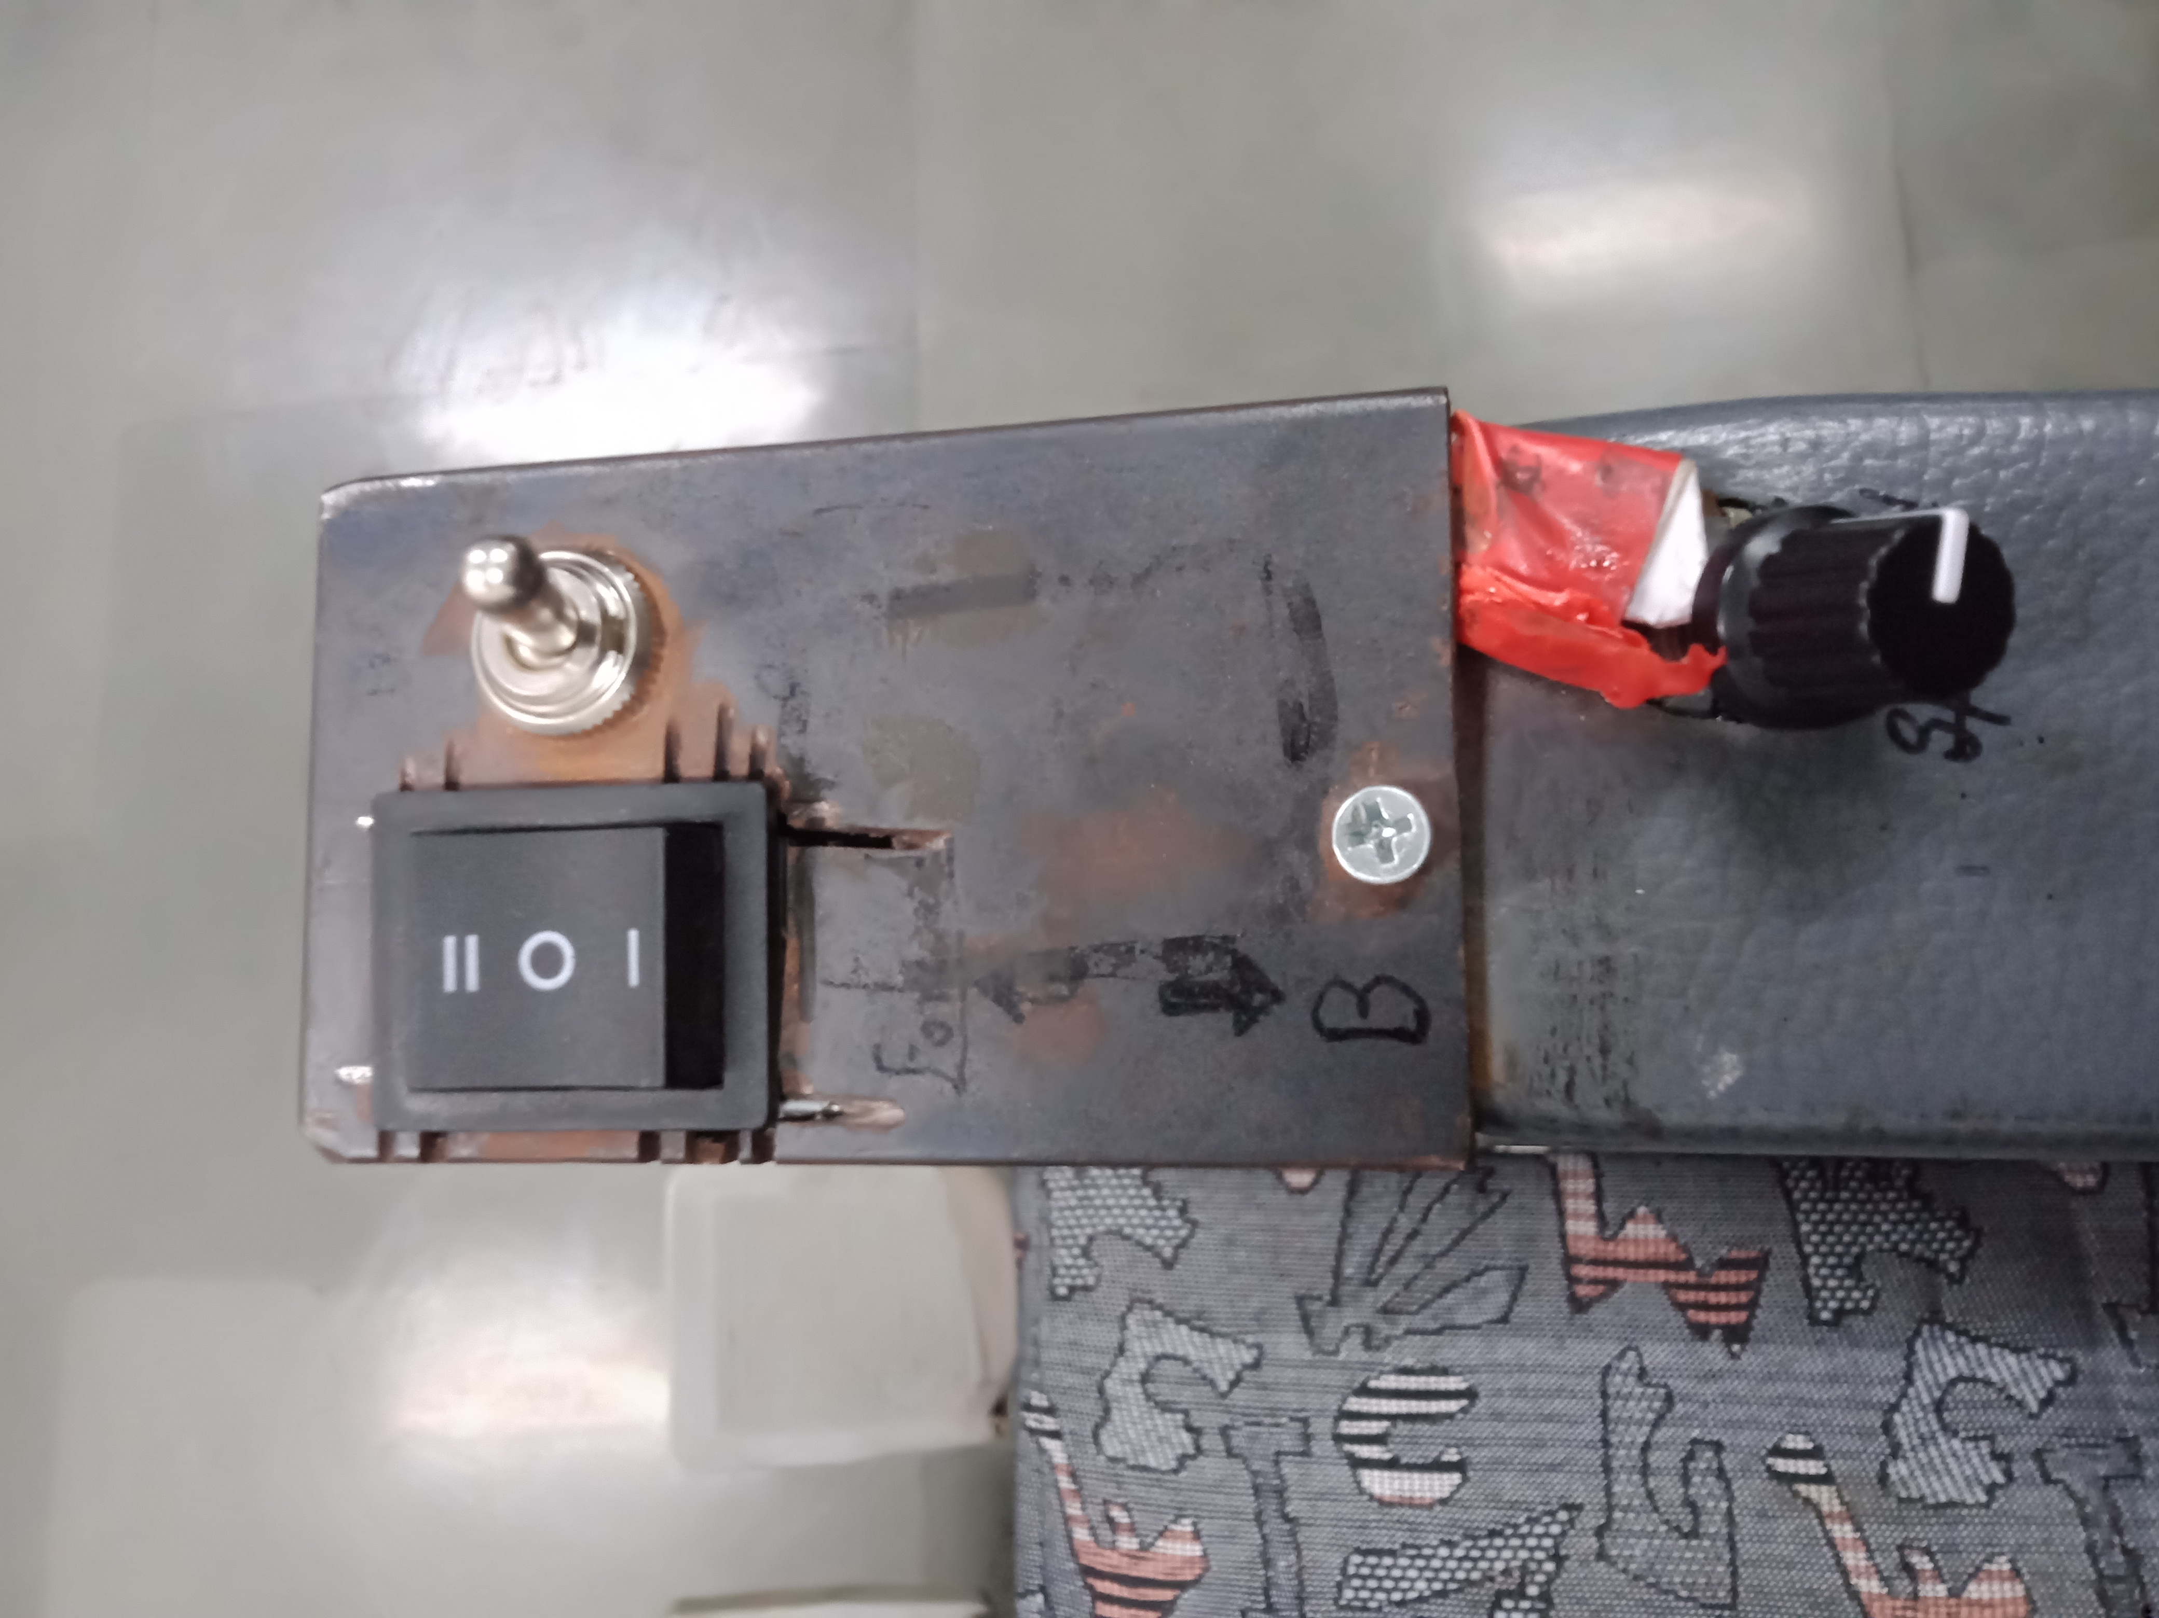
VALIDATION
Lithium ferric phosphate battery
Control switches
Seat elevation switch
Speed controller

Slide 10
Cost Estimation
Components | Quantity | Price(INR)
STM32F401RE | 1 | 1500
Battery | 1 | 4000
Joystick | 1 | 483
PMDC Motor | 2 | 7000
Ultrasonic Sensor | 1 | 300
Resistor | 1 | 138
Capacitors | 2 | 276
Relay | 4 | 138
Linear Actuators | 1 | 3000
wheels | 4 | 1600
Total Cost Estimated=18,435/-(approx.)

Slide 11
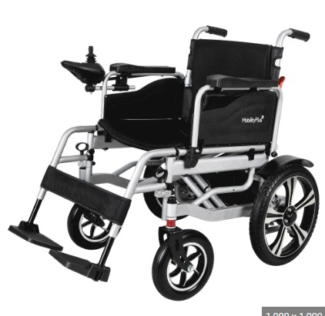
ASSUMPTIONS
The aim of our electronic wheelchair project is to develop a more accessible and advanced wheelchair that enhances the mobility and independence of people with disabilities. To achieve this goal, we will conduct extensive market research to understand the needs and preferences of potential users. Based on our findings, we will design and develop an electronic wheelchair that is more user-friendly, comfortable, and efficient than existing models. Our future plans include refining and improving the design, exploring new features and technologies, and expanding the distribution and availability of the electronic wheelchair to make it more widely accessible to those who need it. We believe that our project will have a positive impact on the lives of people with disabilities, and we are excited to be a part of e-yantra's mission to use technology to make a positive difference in the world.

Slide 12
REFRENCES
National Institute on Disability, Independent Living, and Rehabilitation Research (NIDILRR): The NIDILRR provides information on assistive technology, including electric wheelchairs. You can visit their website at: https://www.acl.gov/programs/national-institute-disability-independent-living-and-rehabilitation-research-nidilrr
United Spinal Association: The United Spinal Association offers resources and information on electric wheelchairs for individuals with spinal cord injuries and other mobility impairments. Their website is: https://www.unitedspinal.org/
The National Mobility Equipment Dealers Association (NMEDA): NMEDA is an organization that assists individuals with disabilities in finding appropriate mobility solutions, including electric wheelchairs. You can find more information on their website: https://www.nmeda.com/
Invacare Corporation: Invacare is a well-known manufacturer of mobility and assistive devices, including electric wheelchairs. Their website provides detailed information on their product range: https://www.invacare.com/
Sunrise Medical: Sunrise Medical is another leading manufacturer of electric wheelchairs. They offer a variety of models designed for different needs. You can explore their range on their website: https://www.sunrisemedical.com/
Permobil: Permobil specializes in power wheelchairs, including highly advanced models with advanced seating and positioning capabilities. Their website provides detailed information on their products: https://permobilus.com/
Pride Mobility Products: Pride Mobility is a well-known manufacturer of power wheelchairs and mobility scooters. Their website offers information on their electric wheelchair models: https://www.pridemobility.com/
Quantum Rehab: Quantum Rehab focuses on power wheelchair technology and offers a range of electric wheelchairs with advanced features. You can find more information on their website: https://www.quantumrehab.com/

Slide 13
THANK YOU

